Slide 1
Identifying Gaps in Marketplace Outreach to Populations with Past Low Enrollment in States with Federally Facilitated Marketplaces
Kaitlyn Donaldson

Slide 2
Individual Marketplaces
During the fourth open enrollment period
  27 states with federally-facilitated marketplaces (FFM)
  6 states with partnership marketplaces
Target populations for outreach → historically underinsured

Slide 3
% of Uninsured Adults Reporting Awareness of the Marketplace
Data from the Commonwealth Fund Affordable Care Act Tracking Survey, Feb-April 2016

Slide 4
Best Practices in Outreach
Culturally appropriate outreach
  Materials available for non-English speakers
  Targeted outreach acknowledging differences in need, concerns
  LGBT-friendly outreach
Community-based partners
    Schools, churches, beauty and barber shops, local grocery or community stores, local organizations
Adapt and adjust outreach

Slide 5
Research Goals
Goal #1: Identify areas with past low enrollment
Measuring enrollment
  QHP purchases as a percentage of uninsured population
  Limitations: lack of data, small population
Mapping enrollment

Slide 6
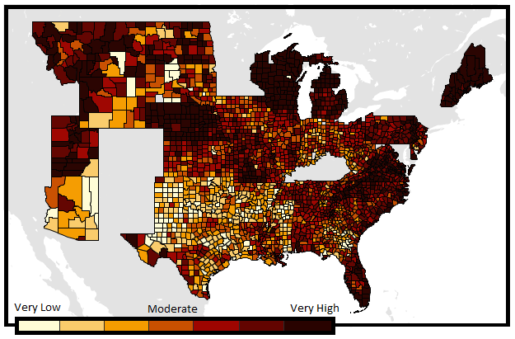
Overall Enrollment, OE3

Slide 7
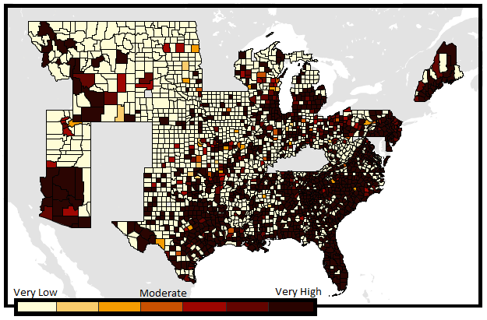
Racial Disparities in Enrollment
Highest enrollment among Asian Americans
Asian American Enrollment, OE3

Slide 8
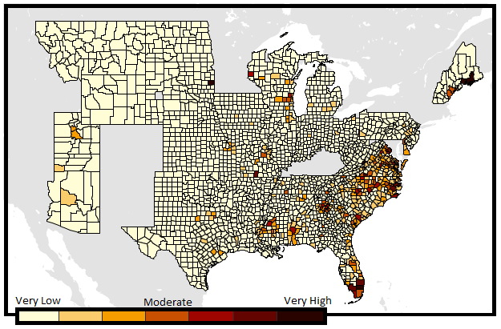
Racial Disparities in Enrollment
Much lower enrollment among African American, Native American, and Hispanic & Latino populations
African American Enrollment, OE3

Slide 9
Research Goals
Goal #2: Assess outreach efficiency
Are more resources invested in areas that have had low enrollment in the past?
Past Enrollment
Outreach

Slide 10
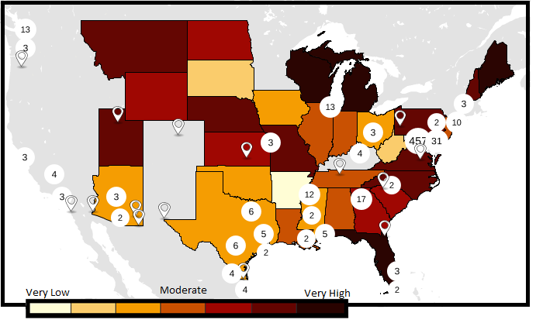
PRG Outreach & Past Enrollment
PRG Events, February 2015 – January 2016

Slide 11
Navigator Grant Recipients
Past Enrollment by State and Navigator Grant Amounts, 2016

Slide 12
Outreach & Past Enrollment
Past Enrollment & Navigator Events by State
February 2016 – January 2017

Slide 13
Outreach & Past Enrollment
Past Enrollment & All CMS Outreach Events by State
February 2016 – January 2017

Slide 14
Research Goals
Goal #3: Assess volume of outreach to racial/ethnic minorities
Is there enough outreach directed towards these populations?

Slide 15
Outreach to Racial & Ethnic Minorities
Distribution of the Uninsured Population by Race/Ethnicity
PRG Events – Did the event target a racial/ethnic minority group?

Slide 16
Outreach to Racial & Ethnic Minorities
Distribution of the Uninsured Population by Race/Ethnicity
Navigator Events – Did the event target a racial/ethnic minority group?

Slide 17
Outreach to Racial & Ethnic Minorities
Distribution of the Uninsured Population by Race/Ethnicity
All CMS Outreach – Did the event target a racial/ethnic minority group?

Slide 18
Outreach to Racial & Ethnic Minorities
Distribution by Race/Ethnicity, 2016

Slide 19
Research Goals
Goal #4: Assess enrollment of and outreach for the LGBT population
Interview with Katie Keith, Out2Enroll
  How has enrollment changed?
  What is the state of outreach towards LGBT individuals?

Slide 20
LGBT Enrollment
Data from the Center for American Progress’s survey on LGBT Americans & Health Insurance

Slide 21
LGBT Outreach
% of Events Targeting the LGBT Population
**About 5% of the uninsured population identifies as LGBT**

Slide 22
Gaps in LGBT Outreach
Resources for closeted LGBT individuals in the South
Culturally competent outreach for LGBT people of color
Underutilization of potential venues for outreach

Slide 23
Trends in LGBT Outreach
Increased outreach to LGBT individuals
More resources available to navigators
Improved outreach for transgender individuals

Slide 24
Recommendations
Improve data collection
    Racial and ethnic minority groups
    LGBT population
Perform targeted and proportionate outreach to racial and ethnic minority groups
    Targeted outreach to each community

Slide 25
Recommendations
Determine the cause(s) of consistently low enrollment
    Insufficient income?
    Bad outreach? No outreach?
Invest in outreach more efficiently

Slide 26
Recommendations
Ensure information about LGBT enrollment is universally accessible to a diverse population
    Geographic regions
    LGBT people of color
    Transgender individuals

Slide 27
Questions?

